Slide 1
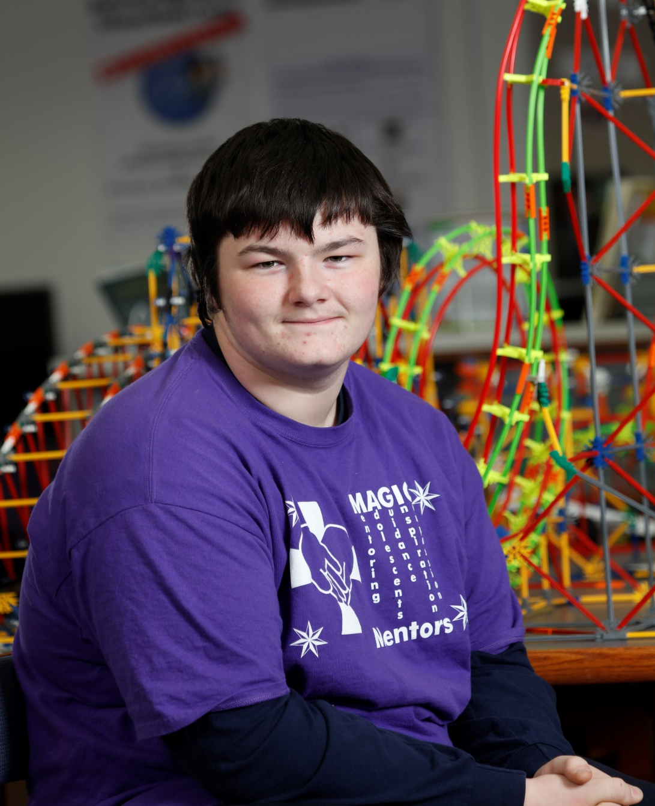
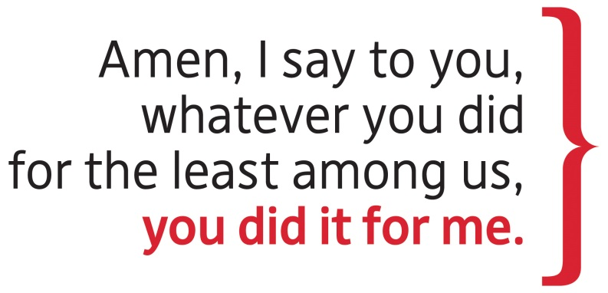
Catholic Charities In-Pew Commitment Weekend
February 11-12, 2017
www.catholiccommunity.org/2017Appeal
“Now, my mind is set on going into welding. Kids who join will benefit a lot from the Magic Mentors program.”

Slide 2
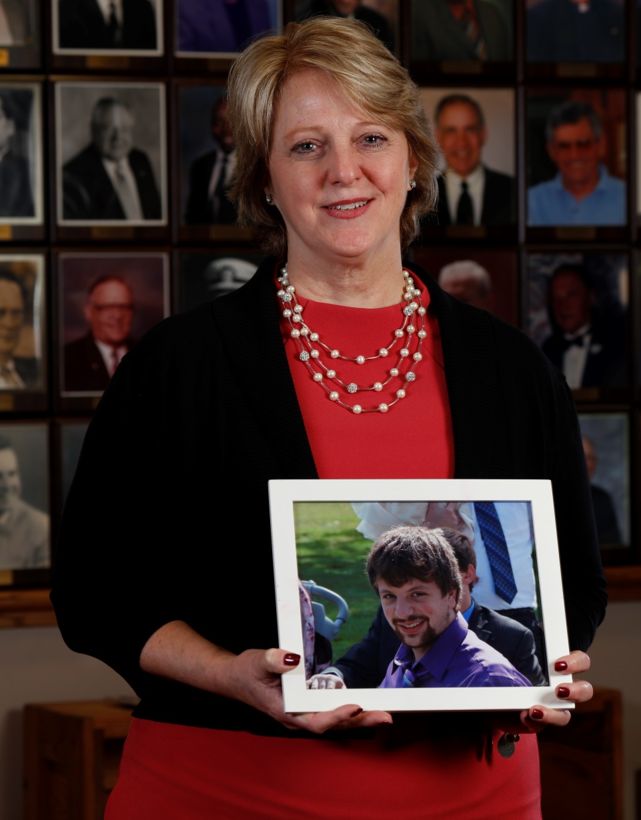
Catholic Charities In-Pew Commitment Weekend
February 11-12, 2017
www.catholiccommunity.org/2017Appeal
Ben found the help he needed at Matt Talbot for Recovering Men.
“He was proud of what he accomplished there. I could see it.”

Slide 3
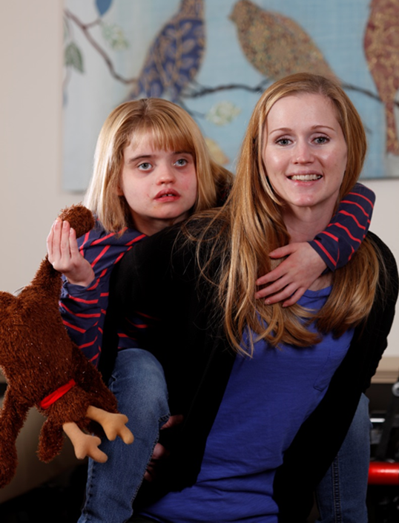
Catholic Charities In-Pew Commitment Weekend
February 11-12, 2017
www.catholiccommunity.org/2017Appeal
“We fell through the cracks with government funding. We ended up living in my parents’ basement with Grace and our two-year-old.
Now, our daughter is happy, safe and in good hands at Rose-Mary.”

Slide 4
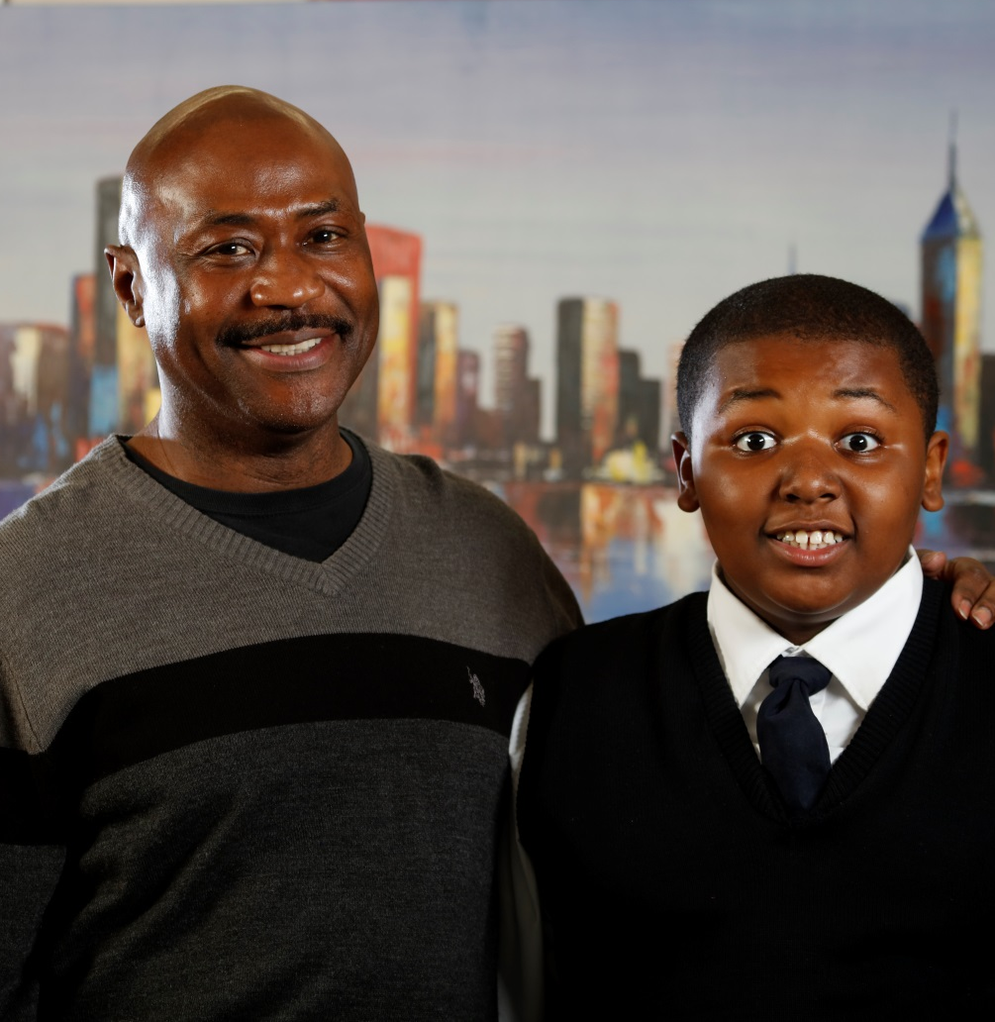
Catholic Charities In-Pew Commitment Weekend
February 11-12, 2017
www.catholiccommunity.org/2017Appeal
“Fatima Family Center was a godsend to our family. It provided us with the opportunity to receive tools necessary to be a complete family.”

Slide 5
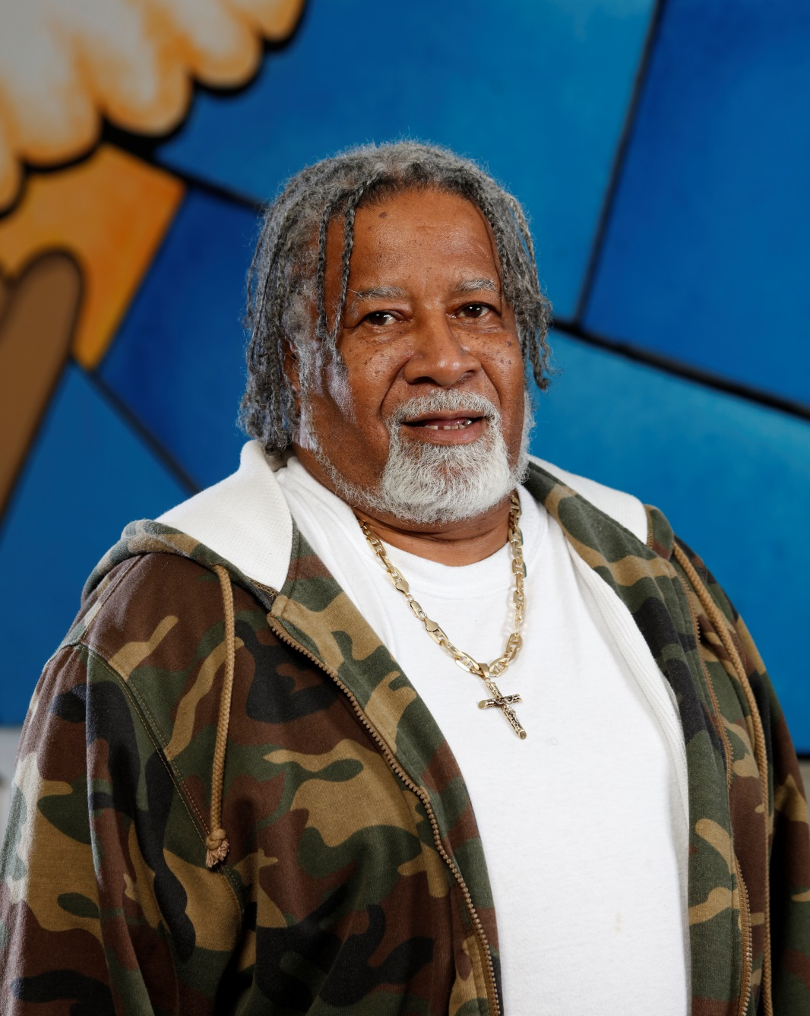
Catholic Charities In-Pew Commitment Weekend
February 11-12, 2017
www.catholiccommunity.org/2017Appeal
“The first time Glen came to
Catholic Charities Community Services of Lorain County, he was homeless.
Now retired, he assists others as a volunteer.”

Slide 6
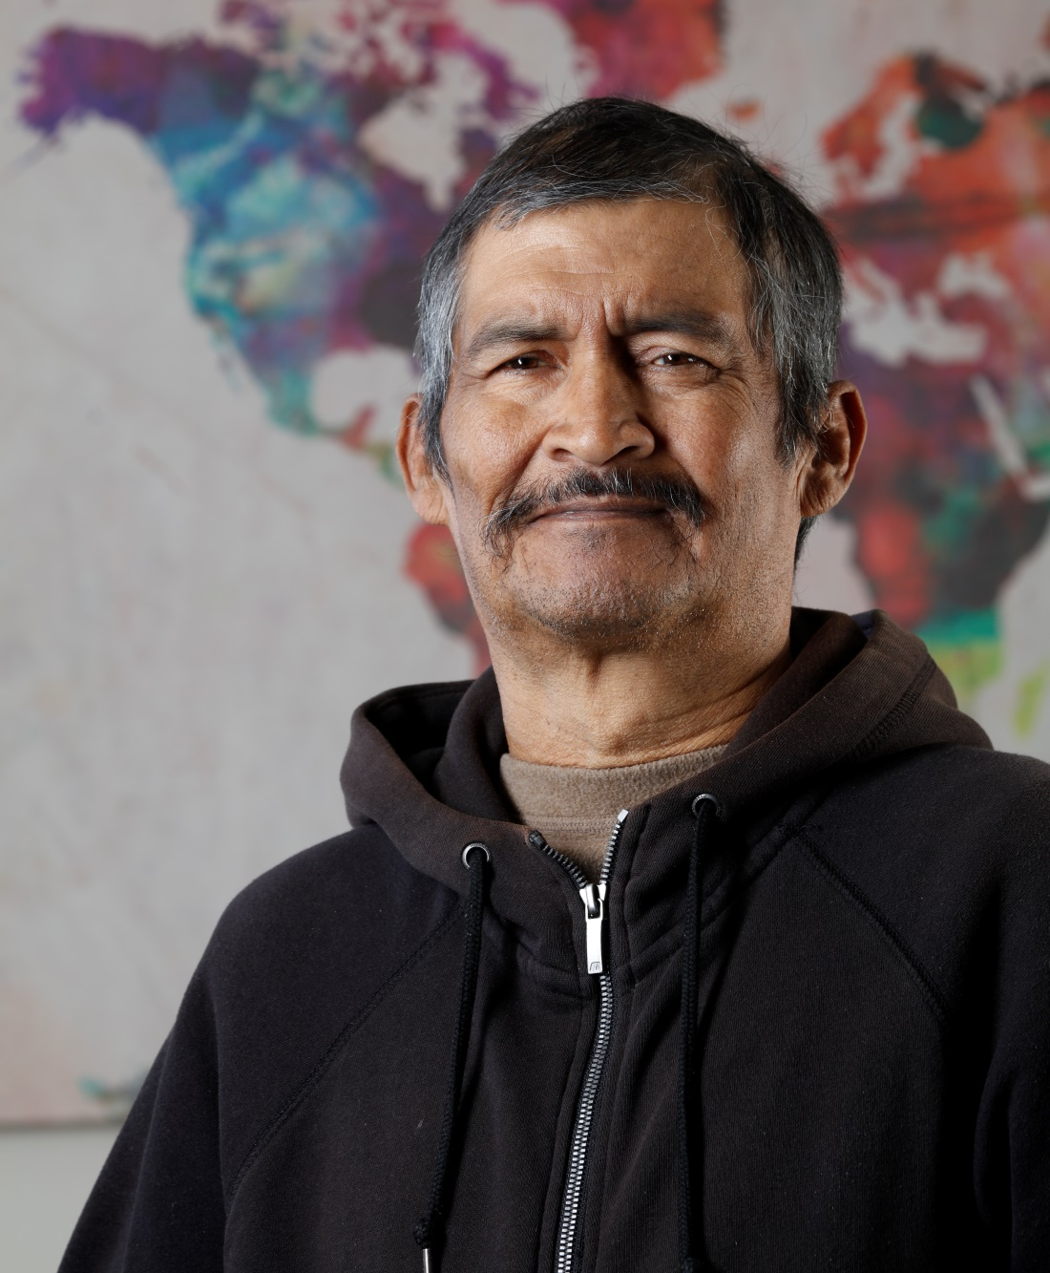
Catholic Charities In-Pew Commitment Weekend
February 11-12, 2017
www.catholiccommunity.org/2017Appeal
When Emilio became a U.S. citizen, the staff at Catholic Charities Community Services of Lake County was there to celebrate.

